Slide 1
Module 5.7.3 HTTP Connections

Slide 2
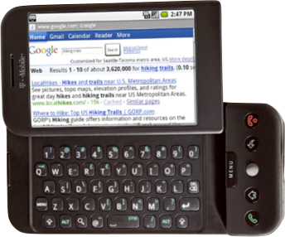

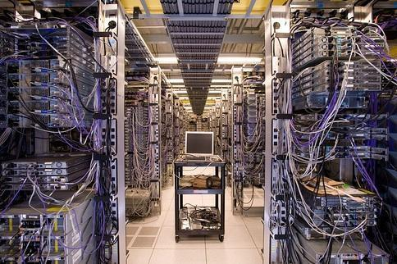
Client
Server
Internet

Slide 3
Internet
HTTP
Request
Python
HTML
JavaScript
Response
GET
Data Store
AJAX
Templates
memcache
CSS
socket
POST

Slide 4
Network Architecture....

Slide 5
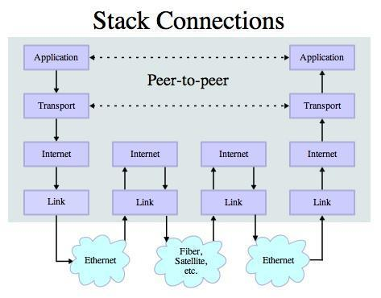
Transport Control Protocol (TCP)
Built on top of IP (Internet Protocol).
Assumes IP might lose some data - stores and retransmits data if it seems to be lost.
Handles “flow control” using a transmit window.
Provides a nice reliable pipe.

Slide 6
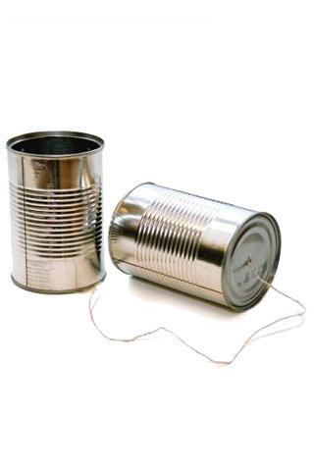
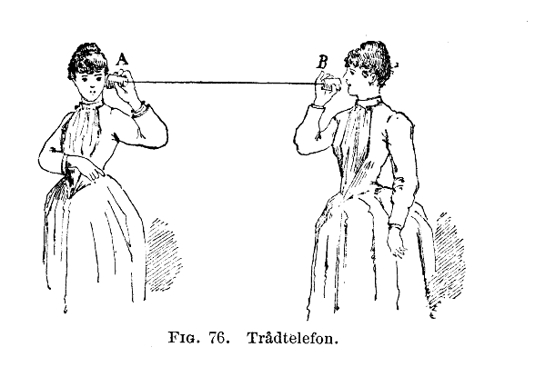
Sockets

Slide 7

TCP Connections / Sockets
“In computer networking, an internet socket or network socket is an endpoint of a bidirectional inter-process communication flow across an Internet Protocol-based computer network, such as the Internet.”
Process
Process
Internet
Socket

Slide 8
TCP Port Numbers
A port is an application-specific or process-specific software communications endpoint.
It allows multiple networked applications to coexist on the same server.
There is a list of well-known TCP port numbers.

Slide 9


www.umich.edu
Incoming
E-Mail
25
Login
23
blah blah blah blah
80
74.208.28.177
Web Server
443
Personal
Mail Box
109
110

Slide 10
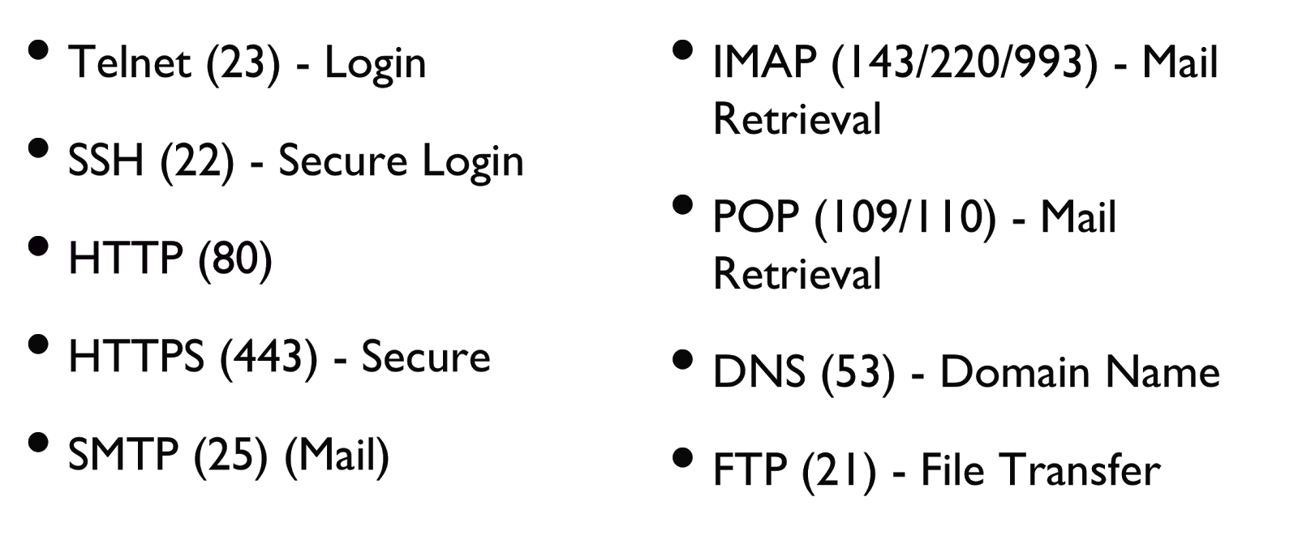
Common TCP Ports

Slide 11
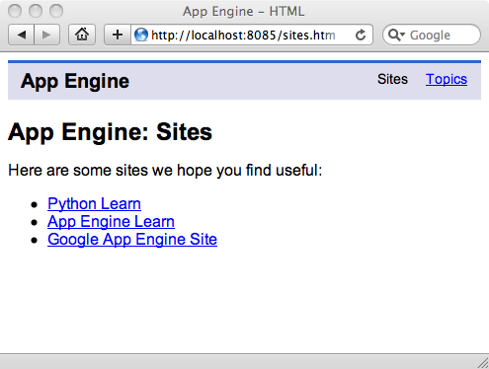
Sometimes we see the port number in the URL if the web server is running on a “non-standard” port.

Slide 12
Sockets in Python
Python has built-in support for TCP Sockets.
import socket
mysock = socket.socket(socket.AF_INET, socket.SOCK_STREAM)
mysock.connect( ('www.py4inf.com', 80) )
Host
Port

Slide 13
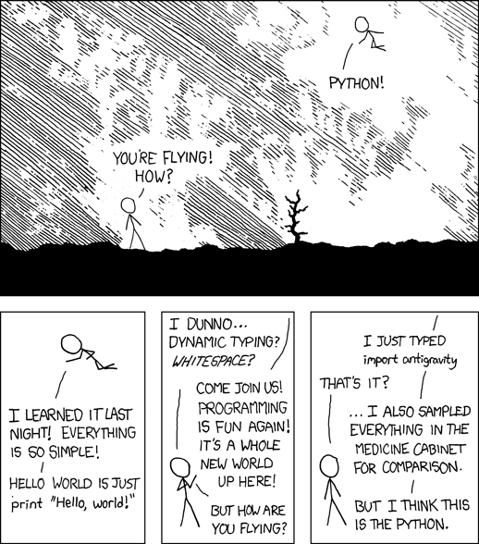

Slide 14
Application Protocol
Since TCP (and Python) gives us a reliable socket, what do we want to do with the socket? What problem do we want to solve?
Application Protocols
Mail
World Wide Web

Slide 15
HTTP - Hypertext Transport Protocol
The dominant Application Layer Protocol on the Internet.
Invented for the Web - to retrieve HTML, images, documents, etc.
Extended to be data in addition to documents - RSS, Web Services, etc..
Basic Concept - Make a Connection - Request a document - Retrieve the Document - Close the Connection.

Slide 16
HTTP
The HyperText Transport Protocol is the set of rules designed to enable browsers to retrieve web documents from servers over the internet.

Slide 17
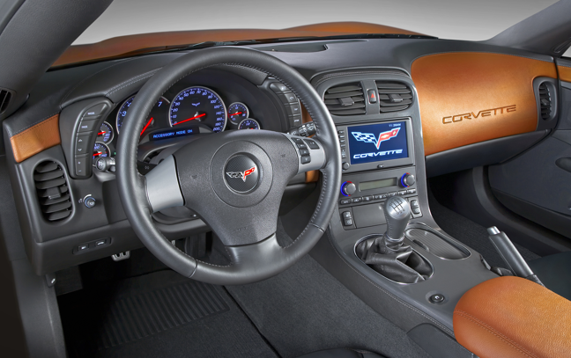
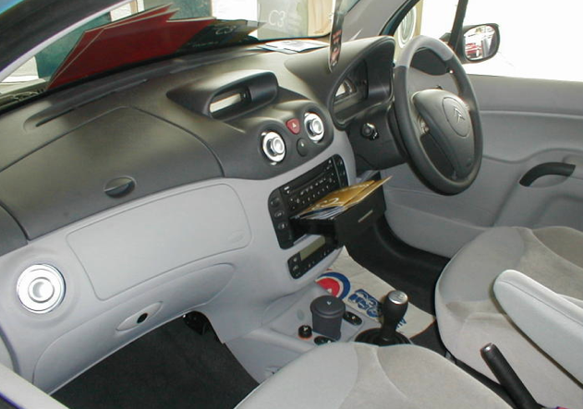
What Is A Protocol?
A set of rules that all parties must follow, so that we may predict each other’s behavior… …and not bump into each other.
On two-way roads in USA, drive on the right-hand side of the road
On two-way roads in the UK, drive on the left-hand side of the road

Slide 18
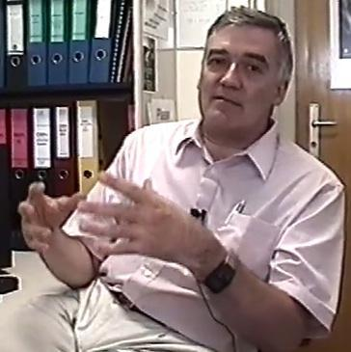
http://www.dr-chuck.com/page1.htm
protocol
host
document
http://www.youtube.com/watch?v=x2GylLq59rI
Robert Cailliau
CERN
1:17 - 2:19

Slide 19
Getting Data From The Server
Each time the user clicks on an anchor tag with an “href=“ value to switch to a new page, the browser makes a connection to the web server and issues a “GET” request - to GET the content of the page at the specified URL.
The server returns the HTML document to the browser, which formats and displays the document to the user.

Slide 20
Making An HTTP Request
Connecting to the web server. Example: http://www.dr-chuck.com/
Request a document (or the default document)
GET http://www.dr-chuck.com/page1.htm
GET http://www.mlive.com/ann-arbor/
GET http://www.facebook.com

Slide 21
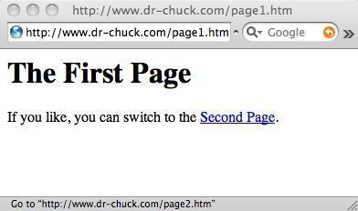
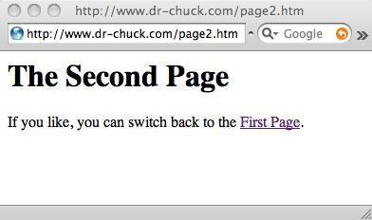
Web Server
<h1>The Second Page</h1>
<p>If you like, you can switch back to the <a href="page1.htm">First Page</a>.</p>
80
GET http://www.dr-chuck.com/page2.htm
Browser

Slide 22
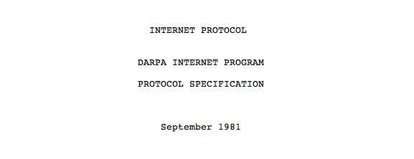
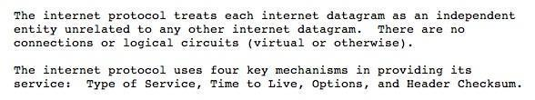
Internet Standards
The standards for all of the Internet protocols (inner workings) are developed by one organization.
Internet Engineering Task Force (IETF).
www.ietf.org
Standards are called Request For Comments (RFC’s).

Slide 23
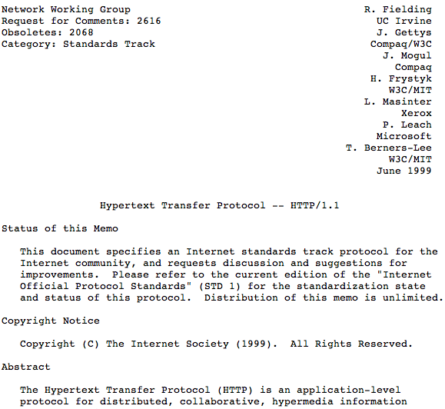
http://www.w3.org/Protocols/rfc2616/rfc2616.txt

Slide 24
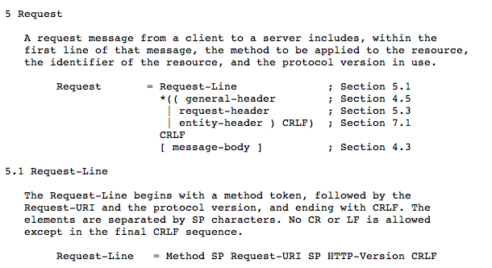

Slide 25
“Hacking” HTTP
Web Server
HTTP
Request
HTTP
Response
$ telnet www.dr-chuck.com 80
Trying 74.208.28.177...
Connected to www.dr-chuck.com.
Escape character is '^]'.
GET http://www.dr-chuck.com/page1.htm
<h1>The First Page</h1>
<p>If you like, you can switch to the
<a href="http://www.dr-chuck.com/page2.htm">Second Page</a>.
</p>
Browser
Port 80 is the non-encrypted HTTP port

Slide 26

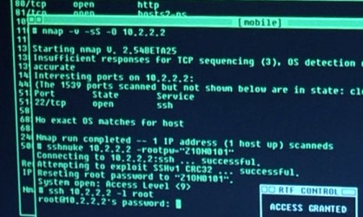
Accurate Hacking in the Movies
Matrix Reloaded
Bourne Ultimatum
Die Hard 4
...

Slide 27
Telnet Connection
$ telnet www.dr-chuck.com 80
Trying 74.208.28.177...
Connected to www.dr-chuck.com.Escape character is '^]'.
GET http://www.dr-chuck.com/page1.htm
<h1>The First Page</h1>
<p>If you like, you can switch to the
<a href="http://www.dr-chuck.com/page2.htm">Second Page</a>.</p>
Connection closed by foreign host.
Notes:
This is how to connect to a webserver using Telnet.
It basically sends a request to the webserver that we want to connect to their server.
When the connection is established you need to specify which method do you want to get the data.
Method types: GET, POST, PUT, DELETE…

Slide 28

Hmmm - This looks kind of Complex.. Lots of GET commands

Slide 29
si-csev-mbp:tex csev$ telnet www.umich.edu 80
Trying 141.211.144.190...
Connected to www.umich.edu.Escape character is '^]'.
GET /
<!DOCTYPE html PUBLIC "-//W3C//DTD XHTML 1.0 Strict//EN" "http://www.w3.org/TR/xhtml1/DTD/xhtml1-strict.dtd"><html xmlns="http://www.w3.org/1999/xhtml" xml:lang="en" lang="en"><head><title>University of Michigan</title><meta name="description" content="University of Michigan is one of the top universities of the world, a diverse public institution of higher learning, fostering excellence in research. U-M provides outstanding undergraduate, graduate and professional education, serving the local, regional, national and international communities." />

Slide 30

...
<link rel="alternate stylesheet" type="text/css" href="/CSS/accessible.css" media="screen" title="accessible" /><link rel="stylesheet" href="/CSS/print.css" media="print,projection" /><link rel="stylesheet" href="/CSS/other.css" media="handheld,tty,tv,braille,embossed,speech,aural" />... <dl><dt><a href="http://ns.umich.edu/htdocs/releases/story.php?id=8077">
<img src="/Images/electric-brain.jpg" width="114" height="77" alt="Top News Story" /></a><span class="verbose">:</span></dt><dd><a href="http://ns.umich.edu/htdocs/releases/story.php?id=8077">Scientists harness the power of electricity in the brain</a></dd></dl>
As the browser reads the document, it finds other URLs that must be retrieved to produce the document.

Slide 31
The big picture...
<!DOCTYPE html PUBLIC "-//W3C//DTD XHTML 1.0 Strict//EN" "http://www.w3.org/TR/xhtml1/DTD/xhtml1-strict.dtd">
<html xmlns="http://www.w3.org/1999/xhtml" xml:lang="en">
<head>
<title>University of Michigan</title>
....
@import "/CSS/graphical.css"/**/;
p.text strong, .verbose, .verbose p, .verbose h2{text-indent:-876em;position:absolute}
p.text strong a{text-decoration:none}
p.text em{font-weight:bold;font-style:normal}
div.alert{background:#eee;border:1px solid red;padding:.5em;margin:0 25%}
a img{border:none}
.hot br, .quick br, dl.feature2 img{display:none}
div#main label, legend{font-weight:bold}
...

Slide 32
Firebug reveals the details...
If you haven't already installed the Firebug FireFox extension, then you need to now.
It can help explore the HTTP request-response cycle.
Some simple-looking pages involve lots of requests:
HTML page(s)
Image files
CSS Style Sheets
JavaScript files

Slide 33
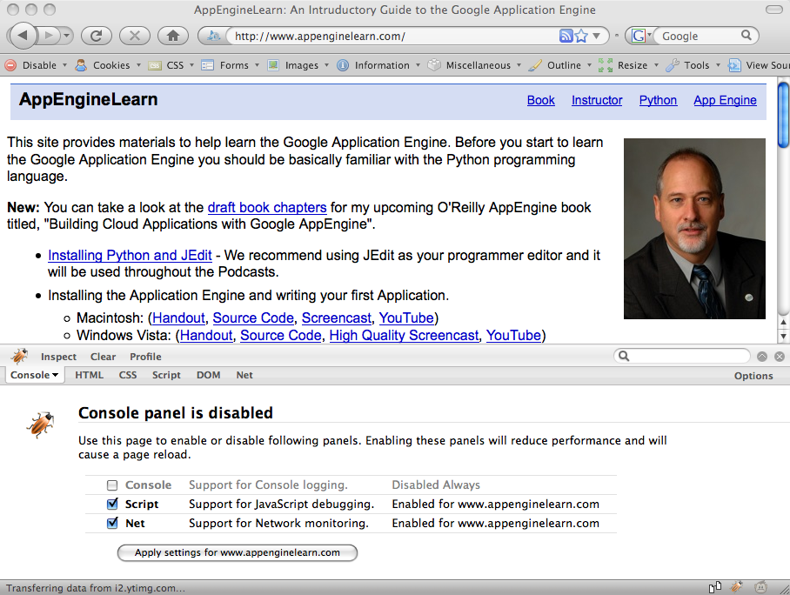

Slide 34
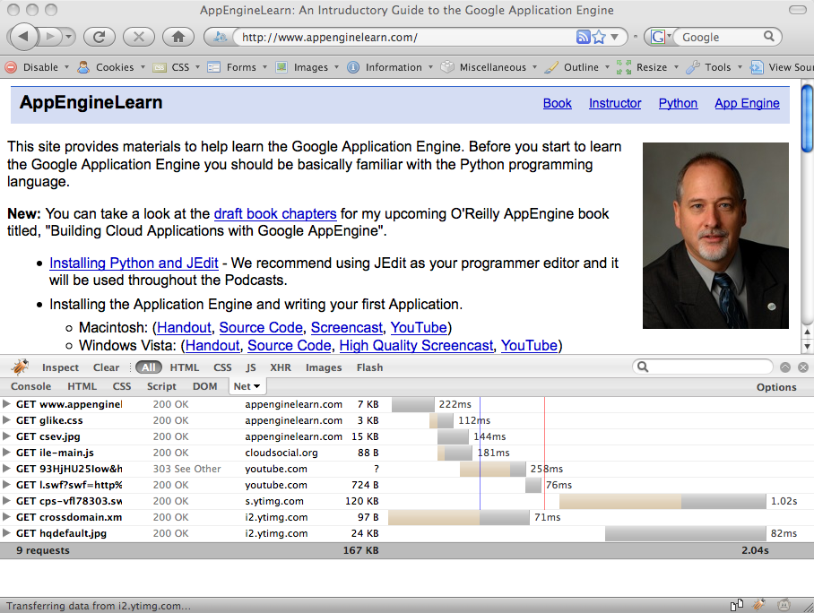

Slide 35
Lets Create a Socket Connection!

Slide 36
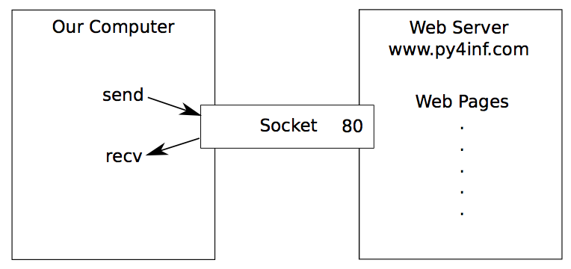
An HTTP Request in Python
import socket
mysock = socket.socket(socket.AF_INET, socket.SOCK_STREAM)
mysock.connect(('www.py4inf.com', 80))
mysock.send('GET http://www.py4inf.com/code/romeo.txt HTTP/1.0\n\n')
while True:
data = mysock.recv(512)
if ( len(data) < 1 ) :
break
print data
mysock.close()

Slide 37
HTTP/1.1 200 OK
Date: Sun, 14 Mar 2010 23:52:41 GMT
Server: Apache
Last-Modified: Tue, 29 Dec 2009 01:31:22 GMT
ETag: "143c1b33-a7-4b395bea"
Accept-Ranges: bytes
Content-Length: 167
Connection: close
Content-Type: text/plain
But soft what light through yonder window breaks
It is the east and Juliet is the sun
Arise fair sun and kill the envious moon
Who is already sick and pale with grief
HTTP Header
while True:
data = mysock.recv(512)
if ( len(data) < 1 ) :
break
print data
HTTP Body

Slide 38
Making HTTP Easier With “urllib”

Slide 39
Using “urllib” in Python
Since HTTP is so common, we have a library that does all the socket work for us and makes web pages appear as a file.
import urllib
fhand = urllib.urlopen('http://www.py4inf.com/code/romeo.txt')
for line in fhand:
print line.strip()

Slide 40
import urllib
fhand = urllib.urlopen('http://www.py4inf.com/code/romeo.txt')
for line in fhand:
print line.strip()
But soft what light through yonder window breaks
It is the east and Juliet is the sun
Arise fair sun and kill the envious moon
Who is already sick and pale with grief

Slide 41
Like A File...
import urllib
fhand = urllib.urlopen('http://www.py4inf.com/code/romeo.txt')
counts = dict()
for line in fhand:
words = line.split()
for word in words:
counts[word] = counts.get(word,0) + 1
print counts

Slide 42
Reading Web Pages
import urllib
fhand = urllib.urlopen('http://www.dr-chuck.com/page1.htm')
for line in fhand:
print line.strip()
<h1>The First Page</h1><p>If you like, you can switch to the<a href="http://www.dr-chuck.com/page2.htm">Second Page</a>.</p>

Slide 43
Going From One Page to The Next...
import urllib
fhand = urllib.urlopen('http://www.dr-chuck.com/page1.htm')
for line in fhand:
print line.strip()
<h1>The First Page</h1><p>If you like, you can switch to the<a href="http://www.dr-chuck.com/page2.htm">Second Page</a>.</p>

Slide 44
Google
import urllib
fhand = urllib.urlopen('http://www.dr-chuck.com/page1.htm')
for line in fhand:
print line.strip()

Slide 45
Parsing HTML (a.k.a. Web Scraping)

Slide 46
What is Web Scraping?
When a program or script pretends to be a browser and retrieves web pages, looks at those web pages, extracts information, and then looks at more web pages.
Search engines scrape web pages - we call this “spidering the web” or “web crawling”.

Slide 47
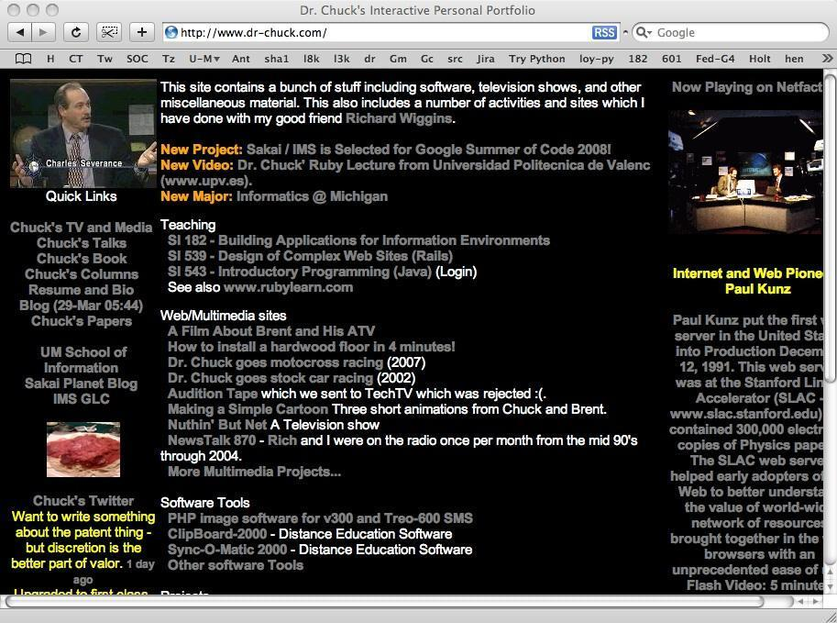
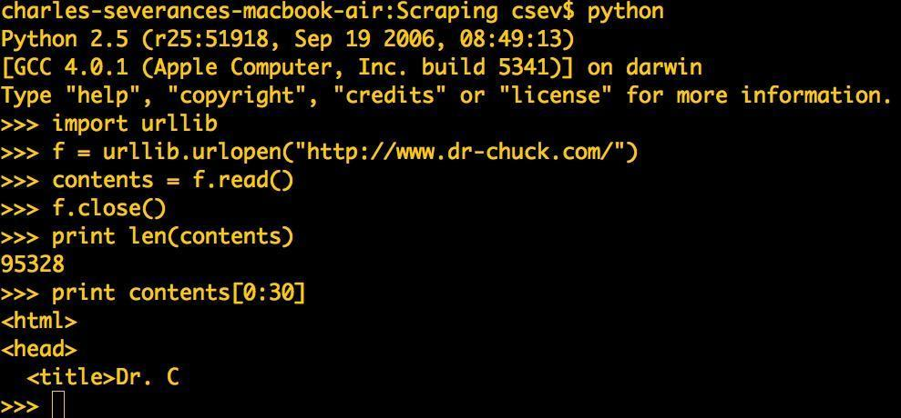
Server
GET
HTML
GET
HTML

Slide 48
Why Scrape?
Pull Data - particularly social data - who links to who?
Get your own data back out of some system that has no “export capability”
Monitor a site for new information
Spider the web to make a database for a search engine

Slide 49
Scraping Web Pages
There is some controversy about web page scraping and some sites are a bit snippy about it.
Google: facebook scraping block
Republishing copyrighted information is not allowed.
Violating terms of service is not allowed.

Slide 50
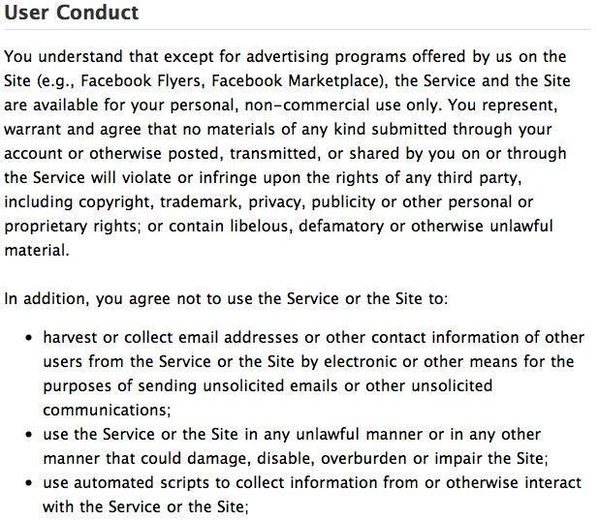
http://www.facebook.com/terms.php

Slide 51
The Easy Way - Beautiful Soup
You could do string searches the hard way…
…or use the free software called BeautifulSoup from www.crummy.com
http://www.crummy.com/software/BeautifulSoup/
Place the BeautifulSoup.py file in the same folder as your Python code...

Slide 52
BeautifulSoup Script To Scrap The Page
import urllib
from BeautifulSoup import *
url = raw_input('Enter - ')
html = urllib.urlopen(url).read()
soup = BeautifulSoup(html)
# Retrieve a list of the anchor tags
# Each tag is like a dictionary of HTML attributes
tags = soup('a')
for tag in tags:
print tag.get('href', None)
urllinks.py

Slide 53
<h1>The First Page</h1><p>If you like, you can switch to the<a href="http://www.dr-chuck.com/page2.htm">Second Page</a>.</p>
html = urllib.urlopen(url).read()
soup = BeautifulSoup(html)
tags = soup('a')
for tag in tags:
print tag.get('href', None)
python urllinks.py
Enter - http://www.dr-chuck.com/page1.htm
http://www.dr-chuck.com/page2.htm

Slide 54
Summary
The TCP/IP gives us pipes / sockets between applications.
We designed application protocols to make use of these pipes.
HyperText Transport Protocol (HTTP) is a simple yet powerful protocol.
Python has good support for sockets, HTTP, and HTML parsing.

